Slide 1
Rheumatoid Arthritis
Dr. Husham Aldaoseri
28 Sep 2023

Slide 2
Overview
Definition of Rheumatoid Arthritis and prevalence
What is the pathogenesis of RA?
What clinical manifestations ?
How do you diagnose RA?
Current treatment
Prognosis

Slide 3
Introduction
Rheumatoid arthritis (RA) is a systemic , chronic inflammatory disease characterized by joint inflammation and destruction in association with serological evidence of autoreactivity.
Affects 1% of the population
 Peak incidence in the 30 to 50 years
 Female-to-male ratio 3:1
 Familial predisposition, with HLA-DR4 association

Slide 4
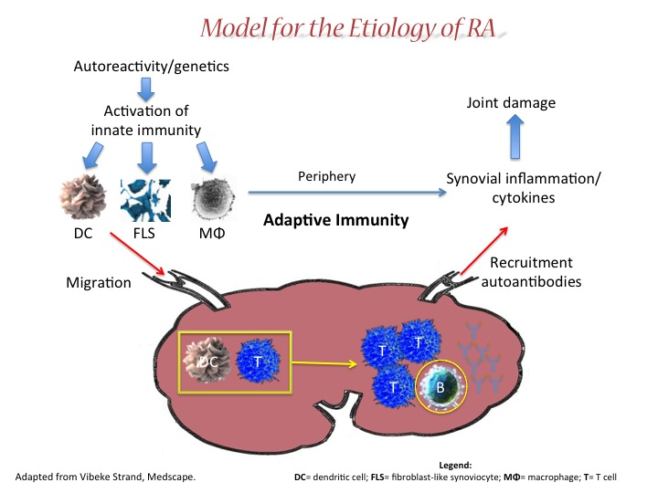

Slide 5





Role of Activated T-Cells in RA
Activation
Activated
T-cell
Activated
Macrophage
Fibroblast
Activated
B-cell
TNF-a
IL-6
MMPs
Autoantibodies, e.g. RF
Inflammation & Joint Destruction

Slide 6
Clinical presentation
Additive, symmetrical polyarthritis affecting both small and large joints
Constitutional manifestation Fatigue, fever, and weight loss may be present reflecting systemic nature of the disease
Joint pain, swelling, erythema, heat, and tenderness may develop acutely or insidiously
Morning stiffness lasts more than 1 hour, and “gel”
phenomenon present after inactivity

Slide 7
Overview of joints affected
Joints most frequently affected in RA include:
    The proximal interphalangeal
    (PIP) and metacarpophalangeal
    (MCP) joints of the hands
    The wrists
    The shoulders
    The elbows
    The knees
    The ankles, and
    The metarsophalangeal (MTP)
    joints of the feet
Distal interphalangeal (DIP)
joints are typically spared
in RA.
Notes:
Rheumatoid arthritis is a chronic, systemic, autoimmune disorder of the joints, usually polyarticular, marked by inflammation of the synovium that leads to erosion of bone and cartilage. [Lipsky in Harrison’s 2005 p1968; Dorland’s 2003 p156; Firestein in Kelley’s pp1002-1006]
The joints most frequently affected in RA include: [Lipsky in Harrison’s 2005 p1971]
The proximal interphalangeal (PIP) and metacarpophalangeal (MCP) joints of the hands
The wrists
The shoulders
The elbows
The knees
The ankles, and
The metatarsophalangeal (MTP) joints of the feet
The exact cause(s) of RA remain(s) unknown, although researchers hypothesize that female gender, genetic predisposition, and environmental triggers may play an important role. [Arthritis Foundation 2007 pp 2-3; Lipsky in Harrison’s 2005 p1968; Klippel 2001 p210]

Slide 8
Untreated, RA can cause joint destruction and disability, beginning in the first year of disease
Ulnar deviation and subluxation of the fingers at the MCP joints, with radial deviation at the wrist
Swan neck deformity (hyperextension of the PIP and flexion of the DIP joints , Boutonnière deformity (flexion of the PIP and hyperextension of the DIP joints.

Slide 10
10

Slide 11
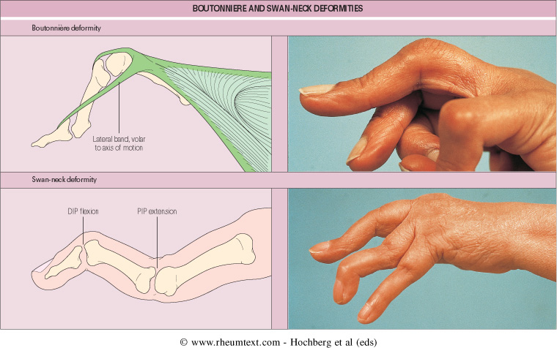

Slide 12
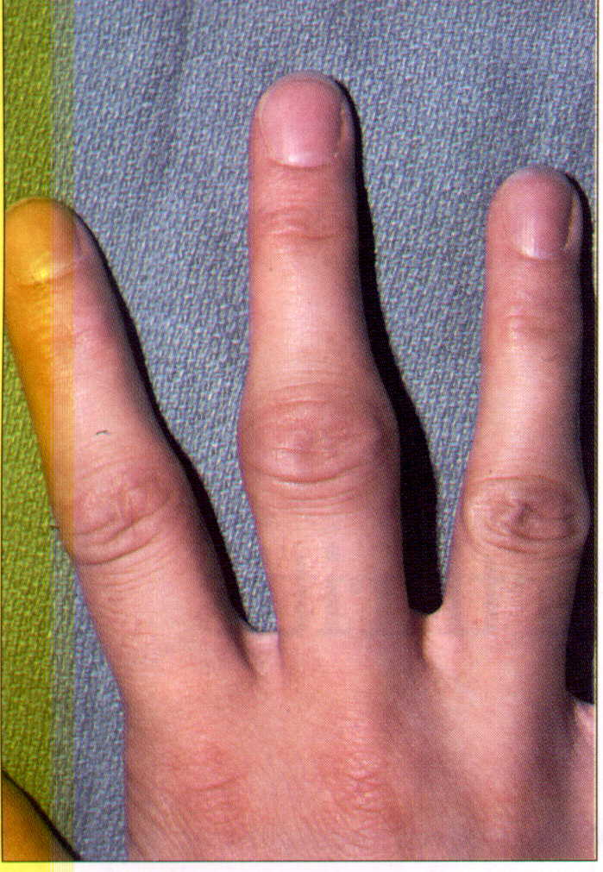
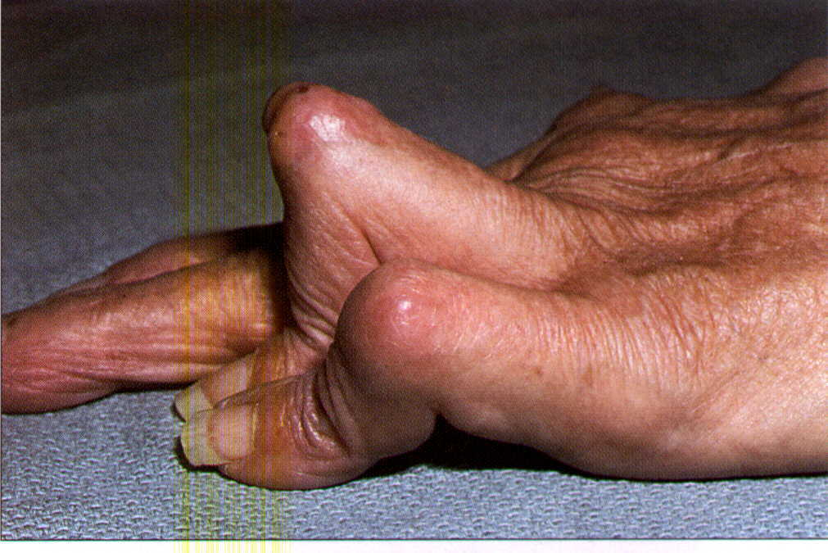
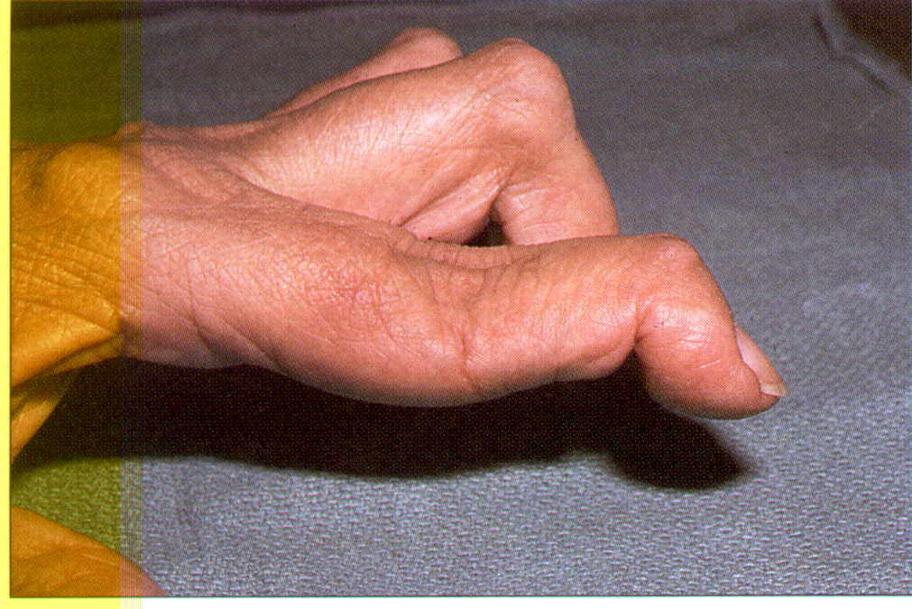
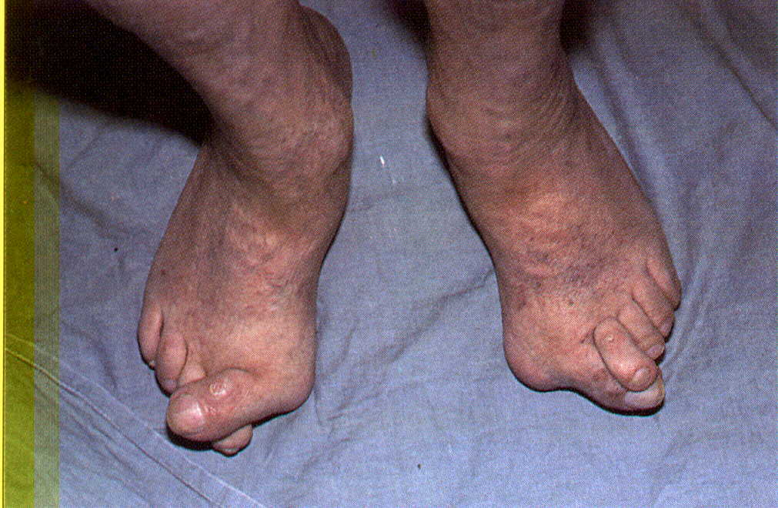

Slide 13
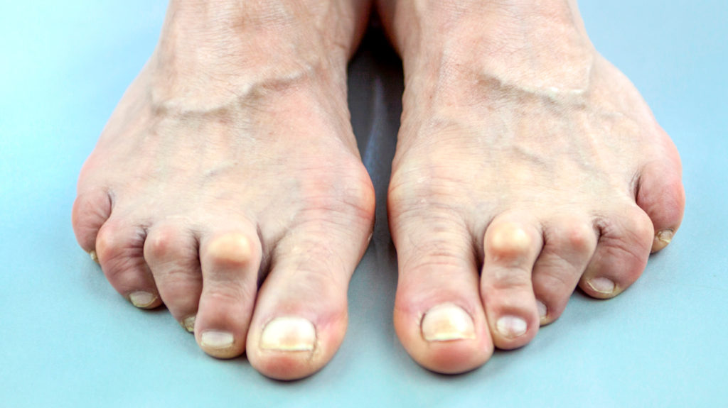

Slide 14
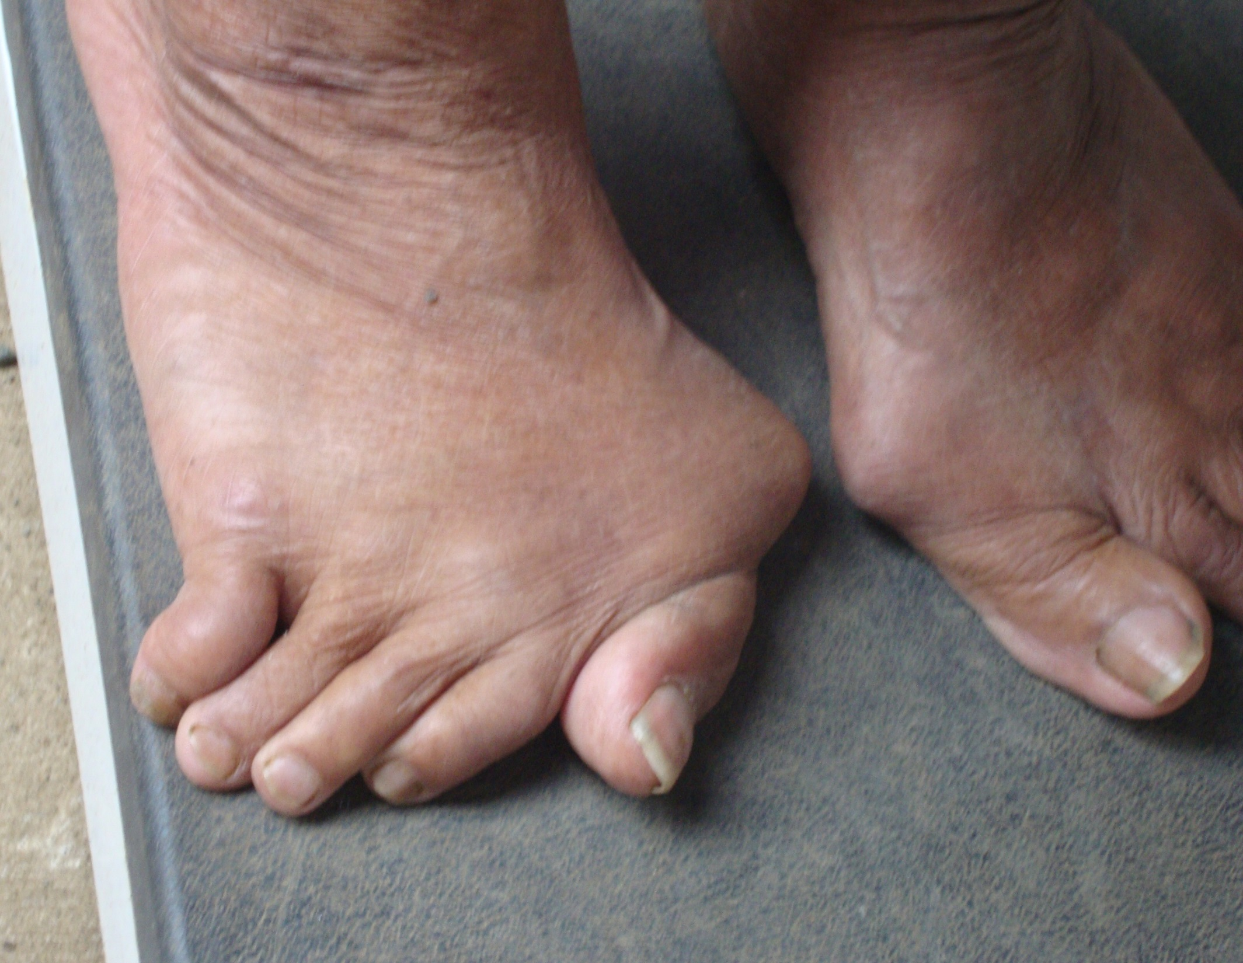

Slide 15
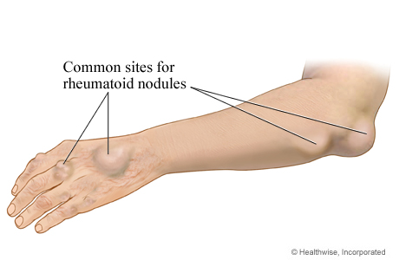
Extra-articular manifestations
 Rheumatoid nodules
 Typically appear on extensor surfaces and pressure points (e.g., olecranon process and Achilles tendon) but may also affect internal organs
 Occur in approximately 25% of patients with RA
 Associated with rheumatoid factor (RF) seropositivity and more severe disease
 Nodules are not specific for RA and can occur in other rheumatic diseases
  Methotrexate can worsen nodulosis, even as inflammatory joint disease improves


Slide 16
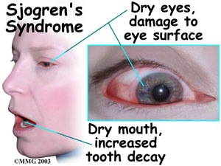
Ocular
 Episcleritis, scleritis, and scleromalacia perforans
Keratoconjunctivitis sicca (secondary Sjogren syndrome)
 Pulmonary
 Pleural disease (effusions exudative and pleural fluid glucose typically low)
Interstitial lung disease and fibrosis
 Bronchiolitis obliterans
 Pulmonary nodules
 Single or multiple
 Nodules may cavitate and pleural nodules cause bronchopleural fistulae
 Caplan disease (nodules with underlying RA and pneumoconiosis)

Slide 17
Cardiac
 Pericarditis and effusions are common but rarely symptomatic
 Constrictive pericarditis, myocarditis, and conduction defects develop rarely
 Hematologic
 Anemia due to iron deficiency (NSAID-associated GI loss) and “chronic disease”
 Felty syndrome (RA associated with splenomegaly,
neutropenia, and leg ulcers)
 Thrombocytosis or thrombocytopenia
 Increased risk for non-Hodgkin lymphoma independent of tumor necrosis factor (TNF) inhibitor use

Slide 18
Neurologic
 Atlantoaxial (C1-C2) instability and subluxation may produce a cervical myelopathy
 Peripheral neuropathy Compression associated with synovitis (e.g., carpal tunnel syndrome)
 Ischemic associated with vasculitis (e.g., mononeuritis multiplex)
 Vasculitis
 cutaneous ulcers, visceral involvement, and mononeuritis multiplex
 Associated with high-titer RF and severe disease

Slide 19
Diagnosis RA

Slide 20
 Clinical presentation highly suggestive in classic cases
 History characterized by insidious onset
 Inflammatory manifestations
 Physical examination reveals Synovitis , Symmetrical polyarthritis
 Renal and hepatic function normal unless the result of drug toxicity
 Normochromic normocytic anemia
 Elevated sedimentation rate and C-reactive protein

Slide 21
Rheumatoid factor (RF)
Antibody reactive against Fc fragment of IgG
70-85% of RA patients are ever seropositive for RF, and is associated with:
More radiological abnormalities
More disease activity
Worse functional ability
More extra-articular manifestations
More treatment with second line drugs
Not specific for RA: chronic infections, cirrhosis, malignancies, other rheumatic diseases.
Notes:
Key message: Rheumatoid factor is present in 80% of RA patients and is associated with more severe disease.
RF is an antibody directed against the Fc component of other antibodies, and is present in approximately 70–80% of patients with RA, although it is not a specific finding for RA and can be present in patients with related disease such as systemic lupus erythematosus (SLE), or in non-rheumatic inflammatory disorders and infections.
RA patients who do test seropositive for RF are more likely to have severe disease, with more aggressive articular disease, a higher frequency of extra-articular manifestations and increased mortality and morbidity. They also require more treatment with second line drugs than patients who are seronegative.
RF may prolong B-cell survival and therefore maintain their own production. This ‘self-perpetuating’ stimulus, in conjunction with complement activation by RF, may collectively contribute to the inflammatory cascade.

Slide 22
Anti–cyclic citrullinated peptide (anti-CCP) antibodies
 Anti-CCP antibody is 68% to 80% sensitive and 98% specific for RA
 Anti-CCP is more likely to be present in early RA than is RF
Radiographic findings
Only soft tissue swelling in early disease
 Periarticular osteopenia
 Uniform joint space narrowing
 Joint margin erosions
 Ulnar styloid erosions
 Atlantoaxial (C1-C2) instability and subluxation

Slide 23
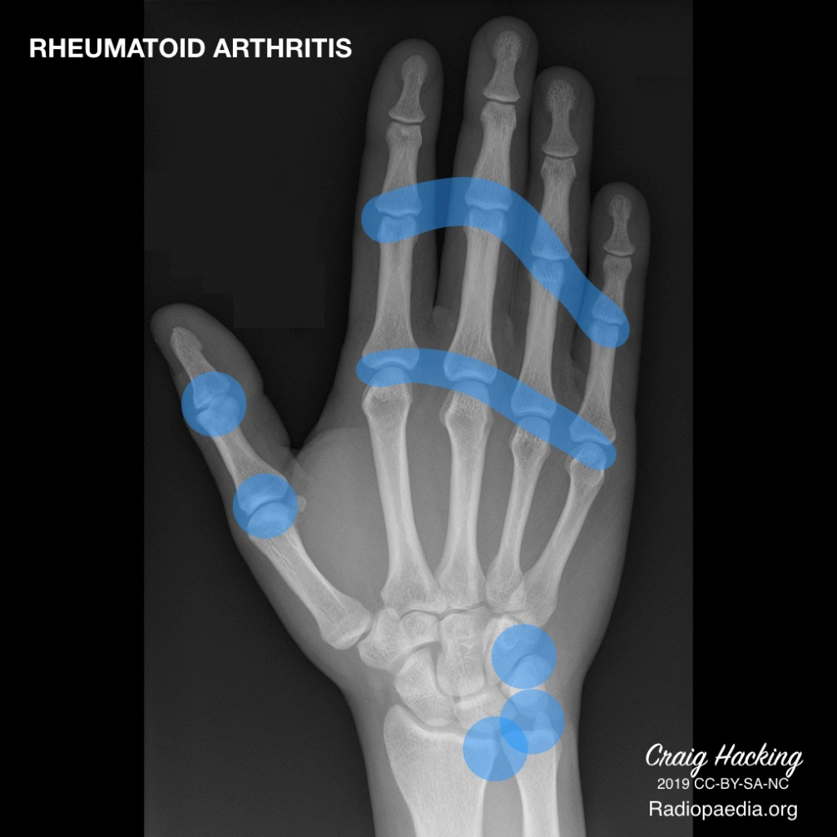
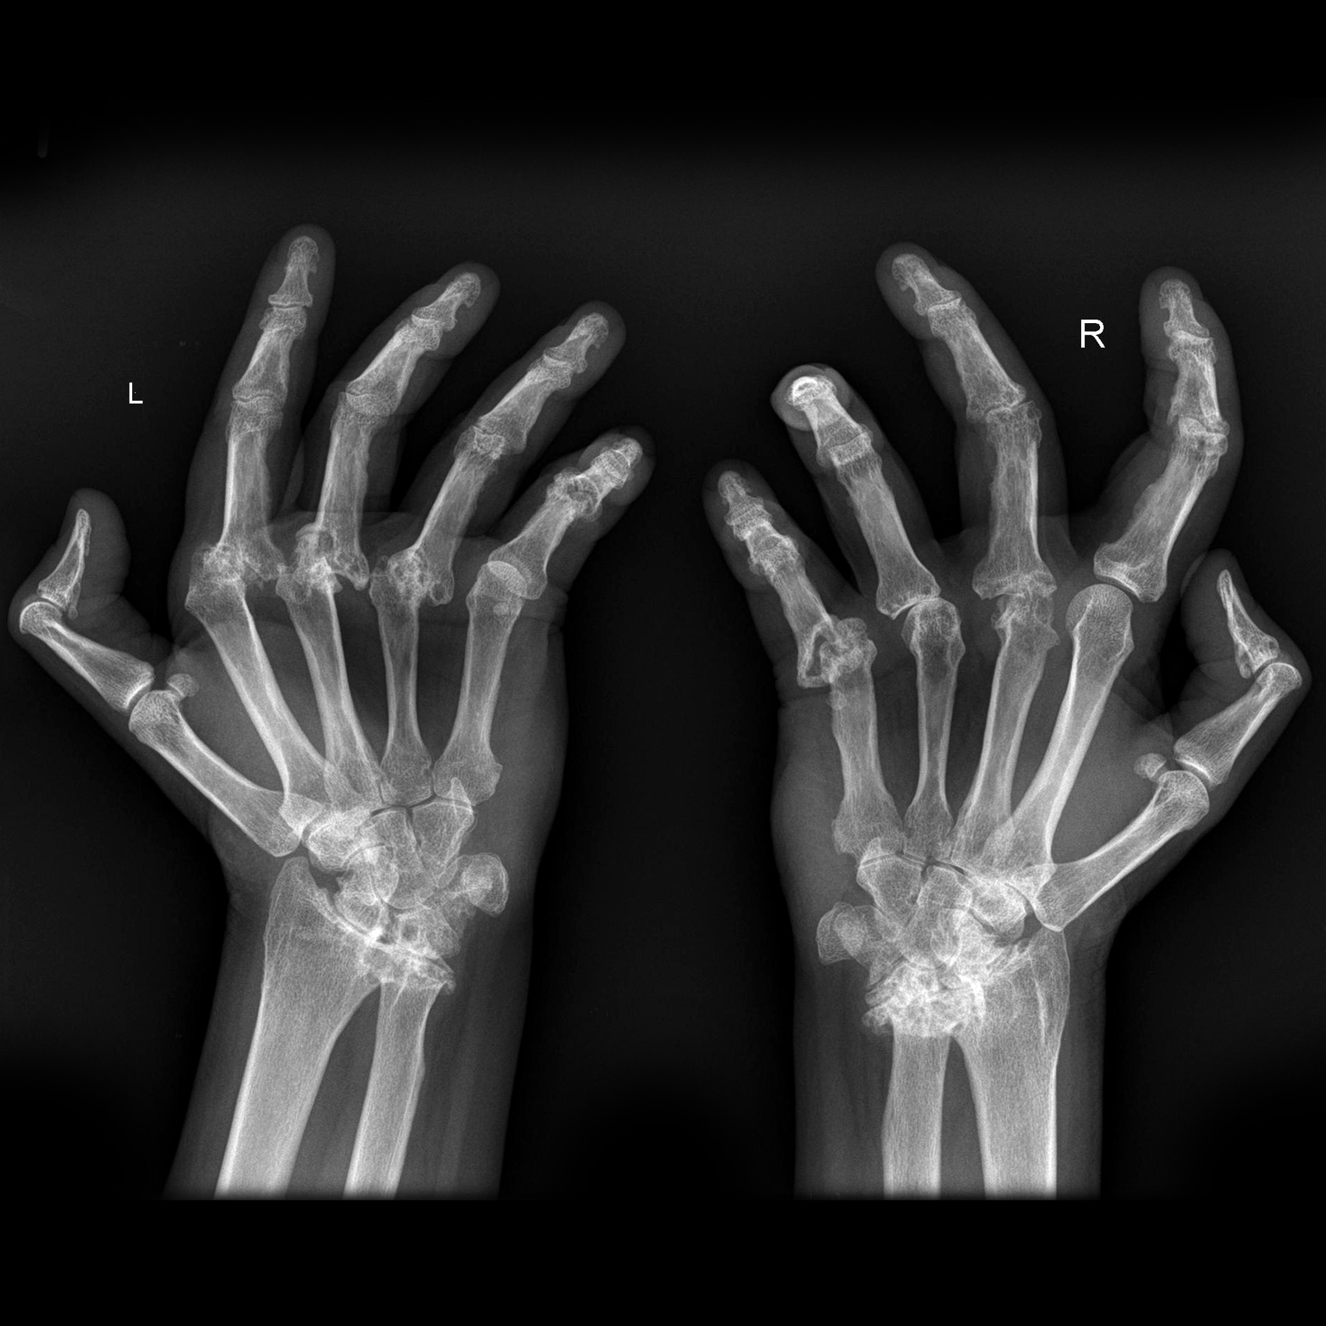
Radiographic findings

Slide 24
2010 ACR/EULAR classification criteria for RA
A score of ≥6/10 is needed to classify RA
A. Joint involvement Score
  1 large joint 0
  2-10 large joints 1
  1-3 small joints (with or without involvement of large joints) 2
  4-10 small joints (with or without involvement of large joints) 3
  >10 joints (at least 1 small joint) 5
B. Serology (at least 1 test result is needed)
  Negative RF and negative ACPA 0
  Low-positive RF or low-positive ACPA 2
  High-positive RF or high-positive ACPA 3
C. Acute-phase reactants (at least 1 test result is needed)
  Normal CRP and normal ESR 0
  Abnormal CRP or abnormal ESR 1
D. Duration of symptoms
  <6 weeks 0
  ≥6 weeks 1
Notes:
-Score-based algorithm: Add score of categories A–D; a score of 6/10 is needed for classification of a patient as having definite RA.
‡ Although patients with a score of <6/10 are not classifiable as having RA, their status can be reassessed
and the criteria might be fulfilled cumulatively over time.
§ Joint involvement refers to any swollen or tender joint on examination, which may be confirmed by
imaging evidence of synovitis. Distal interphalangeal joints, first carpometacarpal joints, and first
metatarsophalangeal joints are excluded from assessment. Categories of joint distribution are classified
according to the location and number of involved joints, with placement into the highest category possible based on the pattern of joint involvement.
“Large joints” refers to shoulders, elbows, hips, knees, and ankles.
“Small joints” refers to the metacarpophalangeal joints, proximal interphalangeal joints, second through fifth metatarsophalangeal joints, thumb interphalangeal joints, and wrists.
** In this category, at least 1 of the involved joints must be a small joint; the other joints can include any
combination of large and additional small joints, as well as other joints not specifically listed elsewhere
(e.g., temporomandibular, acromioclavicular, sternoclavicular, etc.).
†† Negative refers to IU values that are less than or equal to the upper limit of normal (ULN) for the
laboratory and assay; low-positive refers to IU values that are higher than the ULN but 3 times the ULN
for the laboratory and assay; high-positive refers to IU values that are 3 times the ULN for the
laboratory and assay. Where rheumatoid factor (RF) information is only available as positive or negative,
a positive result should be scored as low-positive for RF. ACPA anticitrullinated protein antibody.
‡‡ Normal/abnormal is determined by local laboratory standards. CRP C-reactive protein; ESR
erythrocyte sedimentation rate.
§§ Duration of symptoms refers to patient self-report of the duration of signs or symptoms of synovitis
(e.g., pain, swelling, tenderness) of joints that are clinically involved at the time of assessment, regardless
of treatment status.
24

Slide 25
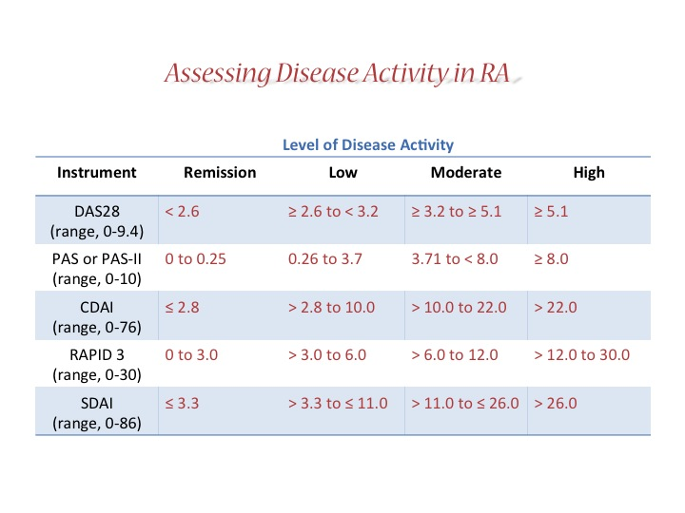
Assessing Disease Activity in RA, Part 1
Assessing Disease Activity in RA
Level of Disease Activity
Instrument | Remission | Low | Moderate | High
DAS28 (range, 0-9.4) | < 2.6 | ≥ 2.6 to < 3.2 | ≥ 3.2 to ≥ 5.1 | ≥ 5.1
PAS or PAS-II (range, 0-10) | 0 to 0.25 | 0.26 to 3.7 | 3.71 to < 8.0 | ≥ 8.0
CDAI (range, 0-76) | ≤ 2.8 | > 2.8 to 10.0 | > 10.0 to 22.0 | > 22.0
RAPID 3 (range, 0-30) | 0 to 3.0 | > 3.0 to 6.0 | > 6.0 to 12.0 | > 12.0 to 30.0
SDAI (range, 0-86) | ≤ 3.3 | > 3.3 to ≤ 11.0 | > 11.0 to ≤ 26.0 | > 26.0

Slide 26
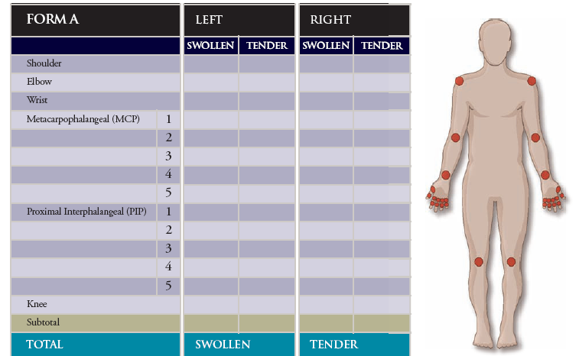

Slide 27
RA: Current Pharmacologic therapy
Agents that are effective in controlling the signs and symptoms of RA, but have no effect on disease progression
  NSAIDs reduce inflammation and pain
  COX-2 inhibitors are similar to NSAIDs, but with improved GI safety and tolerability and higher cardiac side effects
Corticosteroids have anti-inflammatory and immunoregulatory activity, but nominal disease-modifying capability
DMARDs impact the signs, symptoms, and disease progression of RA, as well as improve the quality of life and functionality of the patient

Slide 28
RA: Disease Modifying therapies
Cs DMARDs Biological DMARDS
For example For example
  Methotrexate
TNF antagonists
  Etanercept (Enbrel®)
  Adalimumab (Humira®)
  Infliximab (Remicade®)
  Certolisumab pegol (Cimzia®)
  Golimumab (Simponi®)
Leflunomide
Sulfasalazine
Hydroxychloroquine
Abatacept
Azathioprine, cyclosporine
Rituximab
Tocilizumab (Actemra®)
Tofacitinib (Xeljanz®)

Slide 29
RA Treatment: Targeted Therapies
TNF Biologics
JAK Inhibitors
1998
Etanercept
2012
Tofacitinib
2018
Baricitinib
2002
Adalimumab
2009
Golimumab
Certolizumab
1999
Infliximab
2019
Upadacitinib
2020 (EU)
Filgotinib
2006
Rituximab
2001
Anakinra
2005
Abatacept
2010
Tocilizumab
2017
Sarilumab
Non-TNF Biologics
1. Etanercept PI. 2. Infliximab PI. 3. Anakinra PI. 4. Adalimumab PI. 5. Abatacept PI. 6. Rituximab PI.
7. Golimumab PI. 8. Certolizumab PI. 9. Toclilizumab PI. 10. Tofacitinib PI. 11. Sarilumab PI. 12. Baricitinib PI.

Slide 30
TNF antagonists
5 currently approved agents:
  Etanercept, adalimumab, infliximab, certolizumab pegol, golimumab.
Subcutaneous (etanercept, adalimumab, certolizumab pegol, golimumab) and intravenous administration (infliximab and golimumab.)
Administration in combination with MTX is superior to monotherapy.
Time to onset: rapid (weeks)
Adverse events:
  Infection, TB, multiple sclerosis/demyelination, lupus-like syndrome.
  Malignancy: higher rates as compared with normal population but not higher than the background of lymphoma and solid tumors in RA population. Increased risk of non melanoma skin cancers.
Monitoring:
  TB screening including PPD prior to therapy.
  Hepatitis screeing
  Periodic CBC, LFTs.
  Infection.

Slide 31
Prognosis
up to 10% of cases suffering severe disability.
Cardiovascular disease, infection and secondary amyloidosis are major causes of morbidity and mortality.
Young age at onset, severe disease/disability at presentation, extra-articular manifestations and high RF,ACCP titres all predict a worse prognosis.

Slide 32
Thank you.

